Slide 1
Country-, policy-,
and era-specific features
7
11

Slide 2
The four levels of features
Regime-specific features: related to power and autonomy, answering (1) which actor has and does not have power and/or autonomy in either sphere of social action; (2) what the character of the exercise of power and autonomy is; (3) in what arrangement holders of autonomy and power coexist; and (4) how the given arrangement is maintained, that is, how regime stability is achieved.
Country-specific features: related to a country’s (1) culture, including national and ethnic cleavages, (2) history, including the size of the country and the survival of nomenklatura in general and secret services in particular, and (3) natural endowments, including natural resources and geographical position (and, relatedly, geopolitical position).
Policy-specific features: related to the exact content and (quantifiable) result of policies that certain regimes produce.
Era-specific features: related to a certain age.

Slide 3
Country-specific features
ethnic cleavages (as a source of pluralism and disorder)
deep state and the survival of communist secret services
country size
global ambitions of former empires (China, Russia)
geopolitical orientation (core and follower states in civilizational gravitational fields)
coexistence of liberal and patronal regimes in the European Union
dependence of capitalism (FDI dependence, export dependence)
natural resources and other sources of distributable rent

Slide 4
The disparate logic of EU and US sanctions
 | EU sanctions | US sanctions
launch of sanction proceedings | bureaucratic, cumbersome, may be subject to political bargaining; | partly based on political considerations, but the reporting obligation of the companies approached entails the mandatory launch of proceedings;
suspension of sanction proceedings | may be subject to political bargaining; | the proceedings cannot be suspended; once they are launched, they are no longer within the reach of political bargaining;
targets of sanction proceedings | institutions committing the presumed infringements, making the link between the perpetrator and the crime more difficult to personify and communicate; | persons committing the presumed infringements, allowing the personification of narratives;
underlying message of the selection of targets | it does not address the matter of personal liability, enabling the mafia state’s patronal servants to continue taking part in operating unlawful mechanisms; the chief patron still has the unscathed capacity to maintain krysha; | erosion of the integrity of the adopted political family and the protection provided by the chief patron, dissuading the mafia state’s patronal servants from participating in infringing procedures;
criticism horizon of the sanctions | target the government | target the regime

Slide 5
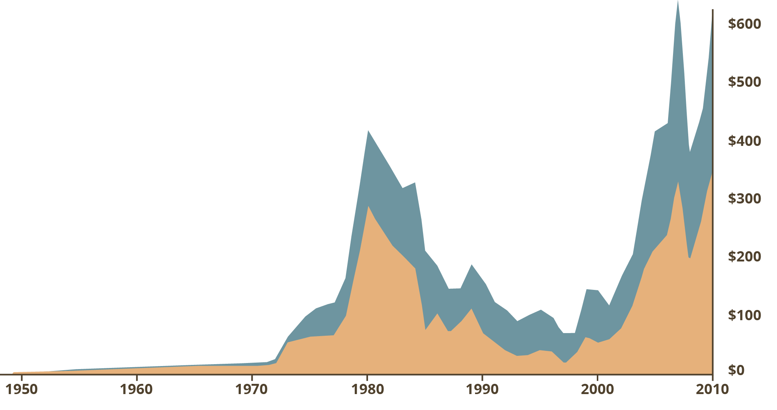
Russian oil and gas rents in 1950-2010
Billions of 2011 US dollars
Oil rents
Gas rents
Source: Gaddy and Ickes (2013, 315)

Slide 6
Policy-specific features: an alternative analytical paradigm
 |  | Patronalization and patrimonialization |  |  | Patronal policy consequences | Public policy consequences
 |  | Institutional dependence | Financial dependence | Personal dependence
Education | Public | Centralization and takeover of public schooling from local governments | Financial decisions delegated to a central body | Ministerial appointment of school principals, employment decisions transferred to district-level authorities | Control of channels of social mobility, restricting freedom of speech of teachers and professors; discretional control over the distribution of budgetary resources | Decreasing student performance (PISA), increasing segregation and dropout
 | Higher | Appointing omnipotent chancellors over the institutions by the chief patron | Turning normative financing a question of institutional bargain, relegating inter-institutional financial decisions to chancellors | Minister can overwrite the Senate’s proposals for Rectors |  | Decreasing number of university students in Hungary, increasing number of emigrating university students
Culture / research |  | Takeover of research institution network of Hungarian Academy of Sciences; establishment of a pro-government academy of arts | Making formerly normative and competitive resource distribution a discretional right of the government | Making artistic life without state funding or membership at the new Academy of Arts economically unviable | Subordinating culture and research to symbolic politics and propaganda (camouflage) | Decreasing diversity of culture and research
Social policy |  | Centralization and takeover of certain social public services from local governments | Resource withdrawal from local governments and NGOs, restricting social budget | Introducing public work in place of some social benefits as a de facto form of servitude | Maintaining patriarchal family order on social level | Decreasing chances of social upliftment, weakening social security, increasing social inequalities

Slide 7
Losses for the leader and policy-making in liberal democracy and patronal autocracy
Losses for the leader
Stimulation threshold
Leader out of power and persecuted (only in patronal autocracy)
Leader out of power, but not persecuted (only in liberal democracy)
Function in liberal democracy
Function in patronal autocracy
Leader loses power to opposition (reaction point)
Level of irritation of policies

Slide 8
Era-specific features
Information technology
China: „digital dictatorship”, Social Credit System (SCS)
digital autarky: Great Firewall of China, restrictive internet regulations in Russia
Climate change
mass migration, the need for global cooperation of different types of regimes

Slide 9
Towards a Global Perspective: Our Axioms for the Post-Communist Region
Genesis axiom: regime development starts from the collapse of monopoly of public ownership ←→ post-colonial countries.
Stateness axiom: the center of the regime is the state as a stable entity, capable of maintaining the monopoly of legitimate use of violence ←→ unstable countries (civil wars, state failure etc.).
Secularism axiom: ruling elites are secular and the polity is dominated by secular power ←→ theocracies.
Party axiom: the highest formal positions are occupied by de jure politicians of political parties ←→ military juntas and monarchies.
Tutelage axiom: the strongest de facto political actor in the regime is a de jure political actor ←→ tutelary regimes (e.g. Iran).

