Slide 1
Politics of stability: public deliberation and the ways it is neutralized
7
5

Slide 2
Political phenomena in the three polar type regimes (1)
 | Liberal democracy | Patronal autocracy | Communist dictatorship
INTERPRETATION OF THE COMMON GOOD | constitutionalism | populism | Marxism-Leninism
 | electoral civil legitimacy | electoral civil legitimacy | non-electoral civil legitimacy
 | public deliberation of the interpretation of the common good | patronal appropriation of the interpretation of the common good | bureaucratic appropriation of the interpretation of the common good
 | legal rational authority | substantive rational authority | substantive rational authority
INSTITUTIONS OF PUBLIC DELIBERATION | open sphere of communication free speech | dominated sphere of communication crowding out/ghettoization | closed sphere of communication censorship
 | competitive/two-party system | dominant-party system | one-party system
 | marketing campaign | loyalty-structuring campaign | rights suspending campaign
 | fair elections | manipulated elections | uncontested elections
 | formal decision-making (in the parliament) MPs are politicians decision-making legislature | informal decision-making (outside the parliament) MPs are political stooges rubber-stamp legislature | formal decision-making (outside the parliament) MPs are party cadres rubber-stamp legislature

Slide 3
Political phenomena in the three polar type regimes (2)
 | Liberal democracy | Patronal autocracy | Communist dictatorship
INSTITUTIONS OF PUBLIC DELIBERATION | rule of law (equality before the law equality after the law) | law of rule (equality before the law inequality after the law) | lawlessness (inequality before the law inequality after the law)
 | limited law citizens subordinated to law | instrumental law law subordinated to the adopted political family | instrumental law law subordinated to the party
 | normative law enforcement | politically selective law enforcement | politically selective law enforcement
 | impartial jurisdiction | politically selective jurisdiction | show trial
 | evidence (crime committed, process launched automatically) | kompromat (crime committed, process launched on the basis of political decision) | fabricated evidence (crime not committed, process launched on the basis of political decision)

Slide 4
Ideologies of civil legitimacy in the three polar type regimes
Constitutionalism (in liberal democracy) | Populism (in patronal autocracy) | Marxism-Leninism (in communist dictatorship)
universalistic protection of human dignity represented by the citizens | particularistic protection of the nation represented by the adopted political family | particularistic protection of the working class represented by the party
individualist | collectivist | collectivist
universalist on humanistic base | nationalist on clan base (amoral familism / tribalism) | internationalist on class base
unlimited moral obligation | limited moral obligation | limited moral obligation
pluralism | anti-pluralism (majoritarian) | anti-pluralism
→ PUBLIC DELIBERATION of the interpretation of the common good: ensuring a variety of competitive processes and channels for the expression and realization of interests and values (the people are citizens) | → PATRONAL APPROPRIATION of the interpretation of the common good: ensuring ultimate authority of the adopted political family in state decision-making without legitimate opposition or criticism (the people are servants) | → BUREAUCRATIC APPROPRIATION of the interpretation of the common good: ensuring ultimate authority of the party in state decision-making without legitimate opposition or criticism (the people are subjects)

Slide 5
Weberian Legitimacy Patterns: Populism as a Call for Substantive-Rational Legitimacy
 | Legal-rational legitimacy (constitutionalism) | Substantive-rational legitimacy (populism, Marxism-Leninism)
Carrier of legitimacy | impersonal institutions (manifested in formal rules) | personal actors (manifested in a formal or informal organization)
Status of ruling elite | subordinated to law | served by law
Resultant process | deliberative: interest reconciliation of multiple actors (taking various interests into account) | declarative: interest enforcement of a single actor (suppressing other interests)

Slide 6
Ideal typical spheres of communication
 | Right to know (obtaining information) | Right to speak (sharing information) | Right to choose (diversity of sources of information) | Right to connect (online information)
Open sphere of communication (media rights are upheld) | allowing access to information of public interest | free speech (the state moderates content) | impartial state media free private (opposition) media | free internet access
Closed sphere of communication (media rights are suppressed) | denying access to information of public interest | censored speech (the state limits content) | directed state media banned private (opposition) media | restricted internet access
Dominated sphere of communication (media rights are neutralized) | hindering access to information of public interest | free speech (the state limits reach) | biased state media crowded out and ghettoized private (opposition) media | regulated internet access

Slide 7
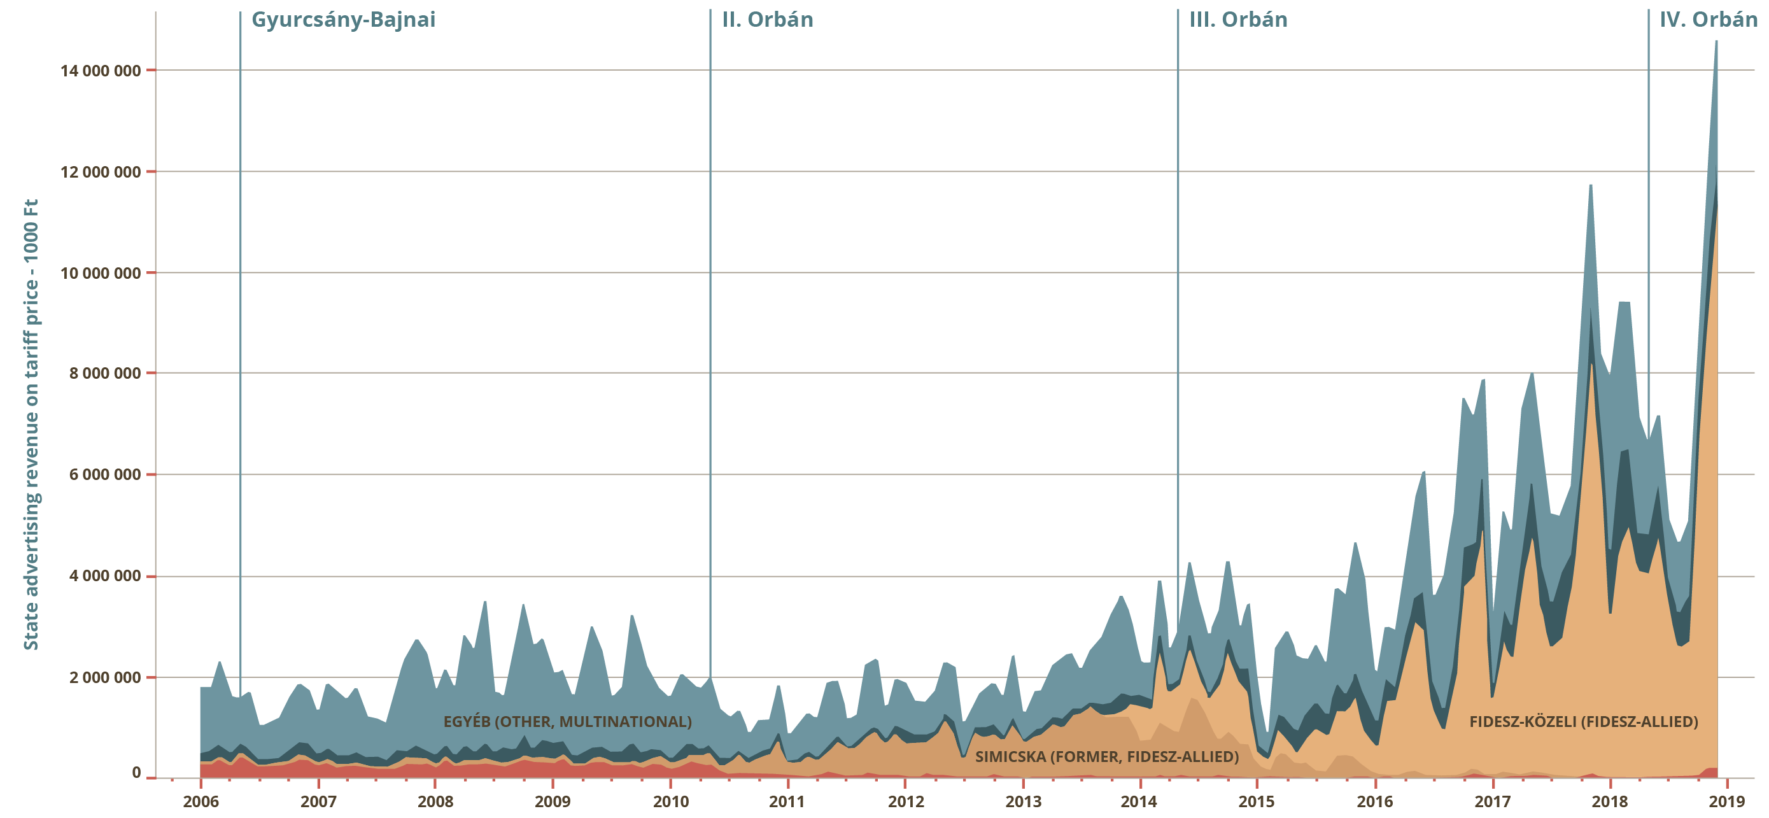
State advertising incomes by political groups in Hungary (2006-2019) measures are in 1000 Ft (approximately 3.5 USD)

Slide 8
Mobilization potential of the people and demobilization potential of the state
 |  | Liberal democracy | Patronal autocracy | Communist dictatorship
Mobilizing structures (of the people) | Formal | freedom of assembly | freedom of assembly | no freedom of assembly
 | Informal | high ability to connect + positive signaling | moderate ability to connect + positive signaling | low ability to connect
Demobilizing structures (of the state) | Direct | authorization is normative (legal remedy) | authorization is discretional (no legal remedy) | no authorization (demonstration is illegal)
 | Indirect | Negotiating / ignoring | Ignoring / channelling / negative signaling / outsourced state repression | n.a.

Slide 9
Types of multi-party systems in post-communist regimes (1)
 | Typical regime type | Type of main cleavage | Type of competition between opposition and the leaders’ party | Type of competition between opposition parties | Main field of competition
Competitive party system | Liberal democracy | Non-patronal | Real | Real | No center (equally dispersed)
Two-party system |  | Non-patronal | Real | Real | Ruling democratic party vs. main opposition democratic party
Democratic party system with autocratic challenger |  | Non-patronal / patronal | Real | Real / n.a. | Ruling democratic party vs. main opposition (patron’s) party
Multi patronal network system | Patronal democracy | Patronal | Real | Real | Ruling patron’s party vs. main opposition patron’s party

Slide 10
Types of multi-party systems in post-communist regimes (2)
 | Typical regime type | Type of main cleavage | Type of competition between opposition and the leaders’ party | Type of competition between opposition parties | Main field of competition
Patronal party system with democratic challenger | Patronal democracy / Patronal autocracy | Non-patronal / patronal | Real | Real / n.a. | Ruling patron’s party vs. opposition democratic party (bloc)
Dominant-party system with competitive fringe | Patronal autocracy | Non-patronal | Real / fake | Real | Opposition parties against each other
Dominant-party system with fake opposition |  | n.a. | Fake | Fake | n.a.

Slide 11
Campaigns in the three polar type regimes
Marketing campaign (dominant in liberal democracy) | Loyalty-structuring campaign (dominant in patronal autocracy) | Rights suspending campaign (dominant in communist dictatorship)
free choice | unfree choice | no choice
bottom-up (non-state conducted) | top-down (mafia state conducted) | top-down (party state conducted)
periodic | occasional/permanent | occasional/periodic
competitive campaign (for convincing the people) | floor-monopolizing campaign (for crowding others out) | managing campaign (for coercing a state goal)
no sanction for refusal | no or indirect sanction for refusal | direct sanction for refusal

Slide 12
Types of Elections
 | Adoption of electoral system | Campaign funding of the ruling party | Access to media for the (real) opposition | Neutrality of public institutions
Fair elections | Consensual | Legal | Open Restricted No | Neutral Biased Hand-guided
Unfair elections | Consensual | Legal + illegal
Manipulated elections | One-sided | Legal + illegal
Uncontested elections | One-sided | Legal (+ illegal)

Slide 13
Types of custom-tailored lexes, with general examples for rewarding and punishing policies
Type of target | Patronal policy objective | General example for…
 |  | rewarding policy | punishing policy
Political actor | Disposition over the fulfillment of public offices | lifting conflicts of interest requirements to ensure that the stooges of the adopted political family can be appointed to public positions | the arbitrary removal of persons from public offices enabled by legislation
Political actor (institution) | Disposition over the remuneration of political actors | growing remunerations or support for political stooges of the adopted political family, or the civil and political organization, municipal governments dominated by them | decrease in the remunerations or support of political opponents of the regime in public positions and critical civil or political organizations, municipal governments
Political actor (institution) | Disposition over the competences of political actors | extension of the competencies of the institutions under political stooges, after they are appointed | narrowing competencies of institutions, or municipal and professional bodies monitoring government
Economic actor | Disposition over profitability of economic actors | ensuring positions of advantage to loyal business ventures | removal of businesses not integrated into the adopted political family from the market, or ensuring their takeover
Political / economic / communal actor | Achieving political benefit | making actors non-convictable (even retroactively) who the courts would convict but the adopted political family does not want them to | making actors convictable (even retroactively) who the courts did not convict but the people want them to

Slide 14
The status of law in the three polar type regimes
 | Before the law | After the law
Rule of law (as in liberal democracy) | Equality | Equality
Law of rule (as in patronal autocracy) | Equality | Inequality
Lawlessness (as in communist dictatorship) | Inequality | Inequality

Slide 15
The role of law and legality in three ideal-type political regimes
Liberal democracy | Patronal autocracy | Communist regime
rule of law: citizen subordinated to law | rule by law, law of rule: law subordinated to the adopted political family | lawlessness: law subordinated to the party
equality before the law equality after the law | equality before the law inequality after the law | inequality before the law inequality after the law
normative law-enforcement | individually tailored / politically selective law-enforcement | repressive law-enforcement
impartial jurisdiction | politically selective jurisdiction | show trials
evidence crime committed, process launched automatically | kompromat crime committed, process launched on the basis of political decision | fabricated accusation crime not committed, process launched on the basis of political decision

Slide 16
Democratic and autocratic legalism
 | The spirit of the law regards…
 | Concrete actor(s) (endogenous spirit of the law) | Constitutional system (exogenous spirit of the law)
Democratic legalism (lower-level political actors abuse laws that apply to others) | Red tape (bureaucracy), rules-lawyering (courts) | Applying laws incompatible with constitutionalism and leading to self-destruction of democracy
Autocratic legalism (higher-level political actors abuse laws that apply to them) | Using democratic mandate to create instrumental law | Using democratic mandate to institutionalize autocracy

Slide 17
Institutions of state coercion and their functions
 | Type of organization | Characteristic state function in…
 |  | Liberal democracy | Patronal autocracy
White coercion (default legal use of violence) | Law enforcement agency (police, SWAT etc.) | Normative law enforcement through (threats of) violence | Extortion through selective law enforcement, protection of the adopted political family
 | Revenue agency (tax office, accounting office etc.) | Collection of normatively imposed levies | Extortion through selective inspection and penalties
 | Intelligence agency (secret service etc.) | Surveillance and neutralizing national security threats | Surveillance of formal and informal opposition (parties, NGOs, individuals)
Grey coercion (authorized legal use of violence) | Auxiliary police (self-defense organization etc.) | Part-time reserves of national police force | Helping law enforcement agencies in serving the adopted political family
 | Private protection agencies (security service, private police etc.) | Protection of people and objects of public importance | Protection of people and objects of patronal importance
Black coercion (illegal of use violence) | Fan clubs (ultras, skinheads etc.) | n.a. | Neutralizing protests and other opposition-related activities
 | Paramilitary group (militias etc.) | n.a. | Intimidation, violent resolution of mass opposition activities
 | Organized underworld (criminal groups, classical mafia etc.) | n.a. | Extortion and liquidation of specific targets or opponents of the adopted political family

