Slide 1
Politics of instability: defensive mechanisms, color revolutions, and the forms of reversing autocratic change
6

Slide 2
Defensive mechanisms in the three polar type regimes
 | Liberal democracy | Patronal autocracy | Communist dictatorship
DEFENSIVE MECHANISMS | defensive mechanisms for pluralism | defensive mechanisms against pluralism | n.a.
 | separation of branches of power | separation of resources of power | n.a.
 | free civil society | subjugated civil society | non-existent civil society
 | peaceful change of government (without regime change) | systemic reproduction / regime change | regime change (lawful revolution)

Slide 3
Defensive mechanisms of liberal democracy
First defensive mechanism: separation of branches of power
Second defensive mechanism: public deliberation and the four autonomies of civil society
autonomy of media
autonomy of entrepeneurs
autonomy of NGOs
autonomy of citizens

Slide 4
Different levels of autocratic change
 | The leading political elite successfully disables…
 | first defensive mechanism (separation of branches of power) | second defensive mechanism (autonomy of civil society)
Autocratic attempt | - | -
Autocratic breakthrough | X | -
Autocratic consolidation | X | X

Slide 5
Patronal democracy: the dynamic equilibrium of competing patronal networks
in a liberal democracy, patronal challenger is an anomaly; in patronal democracy, patronal challenge is a norm (multi-pyramid patronal network)
dynamic equilibrium: no patronal network can subjugate the others and become dominant
democratic competition of patronal networks

Slide 6
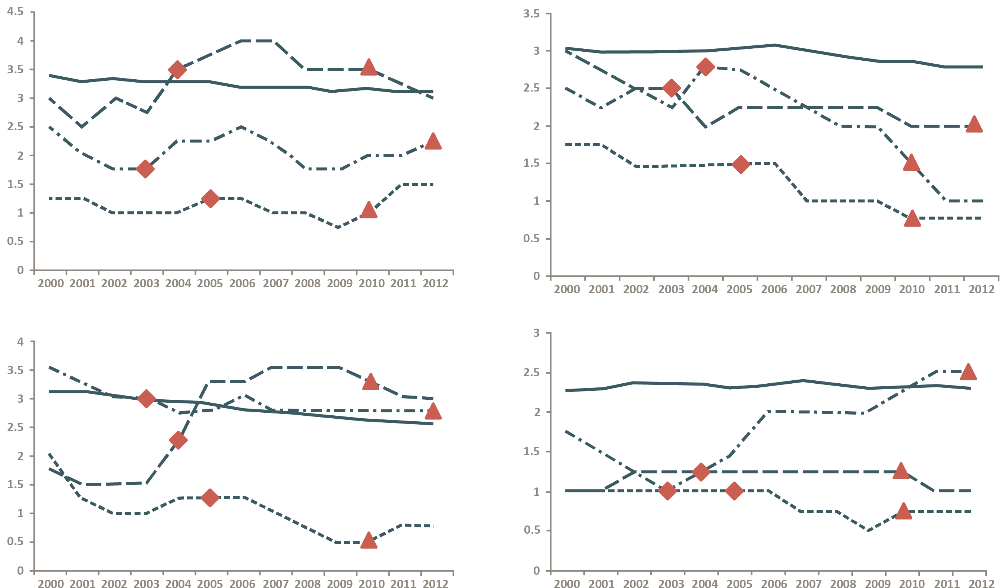
Comparison of democratic governance in the color revolution countries
Electoral Process After the Electoral Revolutions
Judicial Framework & Independence
After the Electoral Revolutions
: Ukraine
: Georgia
: Kyrgyzstan
: average of
post-communist countries
: timing of color revolution
Media Independence After the Electoral Revolutions
Corruption After the Electoral Revolutions
: end of color revolution regime

Slide 7
Processes of regime dynamics and cycles
To From | Liberal democracy | Patronal democracy | Patronal autocracy
Liberal democracy |  | patronal transformation (without autocratic breakthrough) | autocratic breakthrough + patronal transformation
Patronal democracy | anti-patronal transformation |  | autocratic breakthrough
Patronal autocracy | democratic breakthrough + anti-patronal transformation | democratic breakthrough (without anti-patronal transformation)

Slide 8
Autocratic consolidation in numbers
 |  | Improper government influence in civil justice (1: perfectly free of influence; 0: perfectly hand-guided)
 |  | 0.73-0.89 | 0.56-0.72 | 0.39-0.55 | 0.22-0.38
Constraints on government powers (1: perfectly constrained; 0: perfectly arbitrary) | 0.73-0.89 | Estonia, Czech Republic
 | 0.56-0.72 |  | Romania | Georgia, Poland
 | 0.39-0.55 |  |  | Macedonia | Ukraine, Moldova, Kazakhstan, Hungary
 | 0.22-0.38 |  |  |  | Russia, China
 |  | Fundamental rights (1: perfectly protected; 0: perfectly ignored)
 |  | 0.73-0.89 | 0.56-0.72 | 0.39-0.55 | 0.22-0.38
Constraints on government powers (1: perfectly constrained; 0: perfectly arbitrary) | 0.73-0.89 | Estonia, Czech Republic
 | 0.56-0.72 |  | Georgia, Poland, Romania
 | 0.39-0.55 |  | Macedonia, Ukraine, Hungary | Moldova, Kazakhstan
 | 0.22-0.38 |  |  | Russia | China

Slide 9
Separation of resources of power within the single-pyramid patronal network
 | Political power (executive) | Political power (party background) | Economic power (nation-level industrial) | Economic power (nation-level media)
Chief patron | + | + | + | +
Poligarch (1) | + | - | + - | -
Poligarch (2) | - | + | + - | -
Oligarch (1) | + - | - | + | -
Oligarch (2) | + - | - | - | +
Political stooge | - | - | - | -
Economic stooge | - | - | - | -

Slide 10
Ideal type comebacks from different levels of autocratic change
Extra-electoral restitution
Electoral/extra-electoral restitution
Electoral correction
Unchallenged democracy
Autocratic attempt
Autocratic breakthrough
Autocratic consolidation
Unchallenged autocracy

Slide 11
Different levels of democratic change
 | The autocracy’s opposition successfully reinstitutes…
 | First defensive mechanism (separation of branches of power) | Second defensive mechanism (autonomy of civil society)
Democratic attempt | - | -
Democratic breakthrough | X | -
Democratic consolidation | X | X

