Slide 1
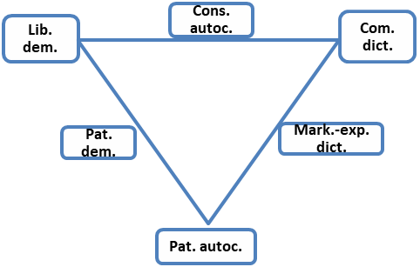
6
70
1
3
5
8
9
10
14
4
7
23
11
13
22
12
2
33
24
20
21
32
25
71
34
28
29
18
31
36
19
30
44
37
35
38
45
26
27
15
17
42
16
54
43
46
47
48
49
39
41
50
40
59
58
51
53
52
55
57
60
63
56
62
65
61
64
66
68
67
69

Slide 2
Lib. dem.
Electoral dem.
Closed auth.
Competitive auth.
Hegemonic auth.

Slide 3
Multi-pyramid power network / Legal-rational legitimacy
Single-pyramid power network / Substantive-rational legitimacy

Slide 4
Totali-tarian
Limited
Unconstrained

Slide 5
Politicians’ party
Cadres’ party
Vassals’ party

Slide 6
State party
Governing party
Transm. belt party

Slide 7
Non-patronal
Bureaucratic patronal
Informal patronal

Slide 8
Formal
Semi-formal
Informal

Slide 9
Burocratic resource redist. / State property
Market coordination / private property
Relational market redistribution / Power&ownership

Slide 10
System-lubricating corruption
System-destroying corruption
System-constituting corruption

Slide 11
Ideology neutral
Ideology driven
Ideology applying

Slide 12
Free
Non-existent
Subjugated

