Slide 1
A Typology of Post-Communist Regimes
Bálint Madlovics
Central European University, Budapest
16/01/2020

Slide 2
The Democracy—Dictatorship Axis
Transitology is replaced by hybridology:
Liberal democracy
Hybrid regimes
Dictatorship
Liberal democracy
Electoral democracy
Competitive authoritarianism
Hegemonic authoritarianism
Closed authoritarianism
Democracy
Autocracy
Dictatorship
First categorization: Larry Diamond, “Thinking About Hybrid Regimes,” Journal of Democracy 13, no. 2 (April 2002): 21.
Second categorization: Marc Morjé Howard and Philip G. Roessler, “Liberalizing Electoral Outcomes in Competitive Authoritarian Regimes,” American Journal of Political Science 50, no. 2 (April 1, 2006): 367
Third categorization: János Kornai, “The System Paradigm Revisited,” Acta Oeconomica 66, no. 4 (1, 2016): 565
Notes:
Hybrid regime helyett grey zone?

Slide 3
Proliferation of political regime categories
Liberal democracies | Hybrid regimes | Dictatorships
Representative democracy (consensual or majoritarian), and further classifications: Polyarchy (Robert Dahl) Participatory democracy (Carol Pateman) Deliberative democracy (Jürgen Habermas) Elitist democracy (John Higley) | Mixed regimes between democracy & dictatorship: Democradura and dictablanda (Guillermo O’Donnell & Philippe Schmitter) Delegative democracy (G. O’Donnell) Illiberal democracy (Fareed Zakaria) Managed democracy (Archie Brown) Competitive authoritarianism (Steven Levitsky & Lucan Way) Electoral authoritarianism (Andreas Schedler) Semi-democracy (Larry Diamond) Liberal autocracy (L. Diamond) Defective democracy (Wolfgang Merkel) Plebiscitary leader democracy (András Körösényi) Externally constrained hybrid regime (A. Bozóki & D. Hegedűs) | Authoritarian & totalitarian regimes: Communist and fascist totalitarian dictatorship (Hannah Arendt, Carl Friedrich & Zbigniew Brzezinski) Post-totalitarianism (Václav Havel) Authoritarianism (Juan Linz)

Slide 4
Renewing and restructuring
the language tools
to describe
post-communist regimes

Slide 5
Problems with mainstream hybridology
Spheres of social actions (political, economic, communal) are presumed to be separated;
It sticks to the political level, disregarding other spheres (like the economy) and the stubborn structures connected to it;
Post-communist systems are described with the language of liberal democracy, and handled as deviant forms of it.

Slide 6
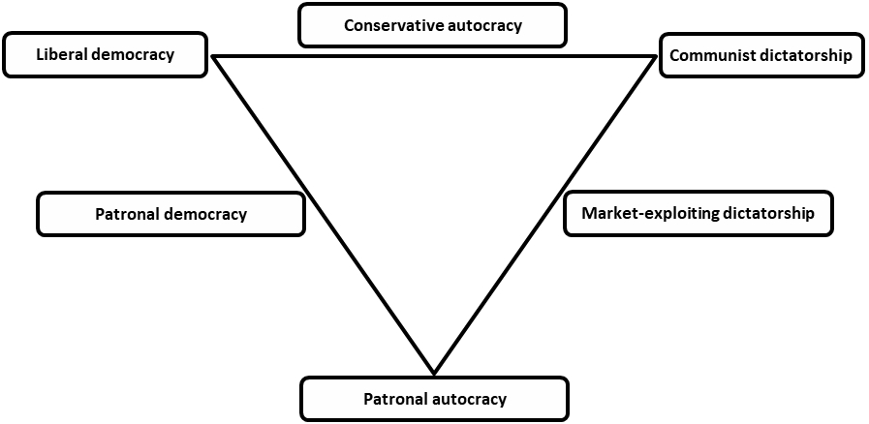
Interpretative Framework of Post-Communist Regimes (combining the political, economic and sociological dimensions)
Estonia
Poland
Czech Republic
Georgia
China
Romania
Macedonia
Ukraine
Moldova
Kazakhstan
Hungary
Russia
(Countries depicted as of 2019.)

Slide 7
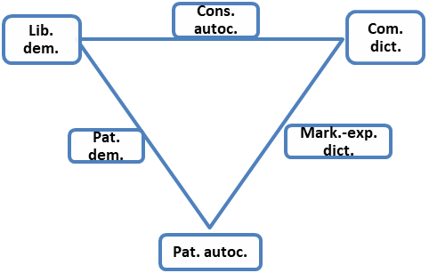
Patronalism of Rule
 | The ruling elite…
 | is organized along patron-client relationships | is within the formal institutional setting | extends beyond the formal institutional setting
Non-patronal | - | X | -
Bureaucratic patronal | X | X | -
Informal patronal | X | - | X
Non-patronal
Bureaucratic patronal
Informal patronal

Slide 8
Formality of institutions
 | Dominant political and economic institutions are…
 | Formal | Informal
Formal | X | -
Semi-formal | X | X
Informal | - | X
Formal
Semi-formal
Informal

Slide 9
Plurality of power networks / legitimacy
 | Presence of opposition elite with winning chances and/or influence on governance
Multi-pyramid power network | X
Single-pyramid power network | -
Multi-pyramid power network / Legal-rational legitimacy
Single-pyramid power network / Substantive-rational legitimacy

Slide 10
Ruling party’s members
 | Members are clients of the leader (top patron) | Members are loyal to the party (as formal organization)
Politicians’ party | - | -
Vassals’ party | X | -
Cadres’ party | X | X
Politicians’ party
Cadres’ party
Vassals’ party

Slide 11
Ruling party’s function
 | Political decisions are…
 | made inside the party’s formal decision-making bodies | limited by checks and balances and/or competition for power
Governing party | X | X
State party | X | -
Transmission-belt party | - | -
Governing party
State party
Transm. belt party

Slide 12
Dominant economic mechanism / dominant form of property
 | The ruling elite is a dominant actor in determining ownership structure | The ruling elite is a dominant actor in determining production structure
Market coordination | - | -
Relational market-red. | X | -
Bureaucratic resource-red. | X | X
Burocratic resource redist. / State property
Market coordination / private property
Relational market redistribution / Power&ownership

Slide 13
Corruption
 | The functioning of the system…
 | is distorted by corruption | is facilitated by corruption | is based on corruption
System-destroying corruption | X | - | -
System-lubricating corruption | - | X | -
System-constituting corruption | - | - | X
System-lubricating corruption
System-destroying corruption
System-constituting corruption

Slide 14
Ideology
 | Basic features of the regime can be derived…
 | from the principle of state neutrality | from the ruling elite’s ideology | from the principle of elite interest
Ideology neutral | X | - | -
Ideology driven | - | X | -
Ideology applying | - | - | X
Ideology neutral
Ideology driven
Ideology applying

Slide 15
Autonomy of civil society
 | Civil society…
 | exists, but its four autonomies are broken | cannot legally exist
Free | - | -
Subjugated | X | -
Non-existent | - | X
Free
Non-existent
Subjugated

Slide 16
6
70
1
3
5
8
9
10
14
2
4
7
23
11
13
22
12
33
24
20
21
32
25
71
34
29
18
31
36
44
37
35
28
19
30
38
27
45
26
15
17
16
54
42
43
46
47
48
49
39
41
50
40
59
58
51
53
52
55
57
60
56
63
65
61
64
62
66
68
67
69

Slide 17
Estonia
Liberal democracy
Patronal autocracy
Market-exploiting dictatorship
Patronal democracy
Communist dictatorship
Conservative autocracy
1985-1991
1964-1985
1992-

Slide 18
Romania
Liberal democracy
Patronal autocracy
Market-exploiting dictatorship
Patronal democracy
Communist dictatorship
Conservative autocracy
1947-1989
1996-2008
2014-
1989-1996
2008-2014

Slide 19
Kazakhstan
Liberal democracy
Patronal autocracy
Market-exploiting dictatorship
Patronal democracy
Communist dictatorship
Conservative autocracy
1964-1984
1985-1991
1992-1994
1995-

Slide 20
China
Liberal democracy
Patronal autocracy
Market-exploiting dictatorship
Patronal democracy
Communist dictatorship
Conservative autocracy
1957-1978
1980-1991
2012-
1991-2012
Notes:
bureaucratic transformation of societal interest és a private appropriation közti konfliktus:
Csanádi
Pártszervezeteket visszaviszik a gazdasági szervezetekbe
Antikorrupciós kampányok (Zhu, Corruption in the Reform Era, 316-318)

Slide 21
Poland
Liberal democracy
Patronal autocracy
Market-exploiting dictatorship
Patronal democracy
Communist dictatorship
Conservative autocracy
1964-1980
1990-2015
2015-
1980-1989

Slide 22
Hungary
Liberal democracy
Patronal autocracy
Market-exploiting dictatorship
Patronal democracy
Communist dictatorship
Conservative autocracy
1949-1968
1990-1998
1968-1990
2002-2010
1998-2002
2010-2018
2018-

Slide 23
Czech Republic
Liberal democracy
Patronal autocracy
Market-exploiting dictatorship
Patronal democracy
Communist dictatorship
Conservative autocracy
1948-1989
1990-2013
2013-

Slide 24
Russia
Liberal democracy
Patronal autocracy
Market-exploiting dictatorship
Patronal democracy
Communist dictatorship
Conservative autocracy
1985-1991
1964-1985
1991-1999
1999-2003
2003-2012
2012-

Slide 25
Ideal type regime cycles from different levels of autocratic change
Extra-electoral restitution
Electoral/extra-electoral restitution
Electoral correction
Autocratic attempt
Autocratic breakthrough
Autocratic consolidation

Slide 26
Ukraine
Liberal democracy
Patronal autocracy
Market-exploiting dictatorship
Patronal democracy
Communist dictatorship
Conservative autocracy
1985-1991
1964-1985
1992-1997
2005-2009
2014-
1998-2004
2010-2013

Slide 27
Macedonia
Liberal democracy
Patronal autocracy
Market-exploiting dictatorship
Patronal democracy
Communist dictatorship
Conservative autocracy
1985-1991
1964-1985
1999-2006
1992-1998
2017-
2007-2016

Slide 28
Republic of Moldova
Liberal democracy
Patronal autocracy
Market-exploiting dictatorship
Patronal democracy
Communist dictatorship
Conservative autocracy
1985-1991
1964-1985
1992-1994
1994-2000
2010-2015
2019-
2001-2009
2016-2019

Slide 29
Georgia
Liberal democracy
Patronal autocracy
Market-exploiting dictatorship
Patronal democracy
Communist dictatorship
Conservative autocracy
1985-1991
1964-1985
2004-2012
1992-1995
2013-
1995-2003

