Slide 1
Towards a Set of Indices for Patronalism
Bálint MADLOVICS – Bálint MAGYAR
CEU DI Seminar
June 15, 2021
1

Slide 2
The Anatomy of Post-Communist Regimes (CEU Press, 2020)
A challenge to the mainstream comparative paradigm
The mainstream approach: implicit axioms
separation of spheres of social action (political, economic, and communal spheres)
dominance of formal institutions: the actor and their action are legally defined, informality is a deviance
data collection: focus on the legally defined → registered activities appearing in statistical databases (the number of parties, election results, ownership of a company, taxed returns etc.)
The challenge: dissolving the implicit axioms. What if…
…the state is not dominantly focused on societal interest?
…not the legally defined structures of dependence and mechanisms of command are dominant, but other ones? …non-formalized patron-client relations are dominant?
…a politician’s actions are not confined to the political sphere?
…the entrepreneur is not the actual owner of „his” company?
Notes:
- létezik a separation of spheres
a formal/legal status coincides with the real with
the states definitely serves public interest

Slide 3
Informality and patronalism in post-communist societies
Root cause
Lack of separation of spheres of social action
(in democratic environment)
Societal structures
Informal networks
Patronal power&ownership
Rulership structures
Adopted political families (informal patronal networks)
Patrimonialization
Systemic distortion
Centralized/monopolized forms of corruption

Slide 4
The mainstream response to measuring informal patronalism
hybrid regimes, „façade” → there is something in the background that defines actual dynamics
What is? No data → endless storytelling (case studies, „process-tracing”)
non-comparative, not ordered by comparable statistical data
the only utilizable statistical data are the ones collected by formal categories
→ vicious circle: formal categories define data collection, the collected data are used in analyses
The more informality becomes dominant, the fewer valid insights we can get from data based on opposing presumptions.

Slide 5
The possibility of measuring informal patronalism
in the Anatomy: ideal types + examples, illustrations
the need for data to fill up the space between theory and illustration
traditional data collection: indicators, as if the de jure and de facto coincided
when formal legal structure and sociological substance do not coincide → de facto relationships exist within the realm of informality and illegality
Proxies:
instead of directly showing the phenomena, only suggesting their presence („indirect indicators”)
can be collected, either in a single research or by compiling a longitudinal database
some utilizable data is currently collected (profits, dividends etc.) but need to be reinterpreted as proxies
a set of proxies measuring informality and patronalism: does not allow for such detailed discussion as a case study, but offers comparability

Slide 6
Definitions of informality and patronalism
Informality is a characteristic feature of a social connection and refers to not having a legal and openly admitted form. In other words, an institution—that is, a humanly devised constraint that structures social interaction—is regarded formal if its rules are not written down and are not made openly accessible to the majority of the population (therefore its rules may or may not be congruent with effective law).
Patronalism is a type of connection between actors where people are connected through vertical chains of command with a strong element of unconditionality and inequality of power. In a patron-client relation, one of the participants—the client—is a vassal (i.e., subordinate) of the other—the patron. A patronal connection is a coercive relationship, involving no free exit from the network (and often no free entry to the network either).

Slide 7
Contrasting non-patronal and patronal relations
 | Non-patronal | Patronal
Institutions | formal | informal
Regulations | normative | discretional
Authorization | collective (authorization) | personal (authorization)
Command | bureaucratic / institutional chains | clientelist / personal chains

Slide 8
Competitive market entrepreneur or politically embedded oligarch?
1

Slide 9
Model differences in the positions of the ideal typical major entrepreneurs and oligarchs
 | Major entrepreneur | Oligarch
Political connections | formal relations dominantly influencing his economic activity (lobbying) voluntary relationship on both sides → remains in the sphere of market action | informal relations dominantly influencing his economic activity (embedded in the ruling elite) patronal relations with the leading political elite → enters the sphere of political action
Political favors | normative regulations, non-excludable favors | discretional regulations, excludable favors
Nature of success | become “major” through technical/organizational innovation remaining “major” does not depend on their personal allegiance to a de jure political actor (can remain profitable without political favors) | become oligarch irrespective of market innovation (securing monopoly grants with patronal support) remaining oligarch depends on their patronal allegiance (depends on political actors maintaining discretional privileges)

Slide 10
How to measure the difference between entrepreneurs and oligarchs?
Legal status is normally accompanied by a measurable and therefore scalable position.
What can we do when the position exists, but it has no legal status?
How to find data that can be used as proxies reflecting the legally undefined, de facto, position?

Slide 11
Possible ways of measuring informal patronalism: proxies of oligarch embeddedness
 | Oligarch | Proxy
Patronal breeding | established by state arbitrariness, special laws or directed privatization | share of assets obtained with the help of state predation / discretional treatment
 | market activity easily monopolized by the state | intensity of competition in the given industry
 | fast ramp-up phase, becoming „national champion” very soon | above-average growth of turnover in the industry
Wealth accumulation | concessions, public procurement with guided bids | odds of winning public procurements
 |  | share of state contracts in total business activity
 | receiving dedicated loans from the patronal network | share of loans from state, state-reorganized, and/or transit-nationalized banks
 | receiving dedicated state subsidies | ratio of state subsidies and total assets
Operation | non-innovative, patronal-network oriented business, optimized for domestic rent-collection | share of production for export
 | overpricing depending primarily on patronal relationships | above-average scale of taxed profits in the industry
Consolidation | profits drawn out of the venture, utilized in other (less transparent) fashion | above-average scale of dividends in the industry
 | self-defending by loyalty demonstration, paying protection monies | financing the chief patron’s hobby (TAO payments: share of football in all ~, share of Felcsút in football ~)
Notes:
TAO: az önkéntes adomány látszata mögött védelmi pénz szedése / beágyazottság vásárlása (self-defending mechanism: a TAO egy példa, de az ajándékozás is!)
Az össz-TAO-ból mennyi megy focira; a foci-TAO-ból mennyi megy Felcsútra
A Felcsútra TAO-zó cégek (Felcsút: az alapítvány alapítója Orbán, tényleges tulajdona: kinevezési jogok, csapatösszeállításba való beleszólás)
árbevételének hány százaléka származik EU-s/költségvetési forrásból; közbeszerzési odds
technology vs. administrative (rent-seeking) coordinator
ratio between the profit of main actor and subcontractors (oligarchs take profit out via subcontractors to hide it)
stability of chains of subcontractors (competition vs. permanent chains)
the value of owned assets vs. those of the subcontractors
turnover / employee

Slide 12
Creating a radar chart of patronalism

Slide 13
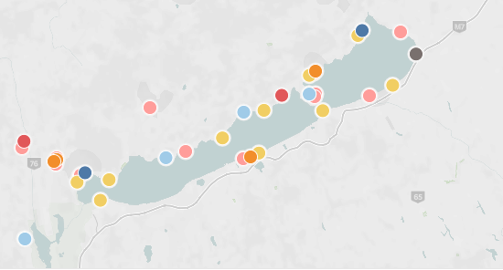
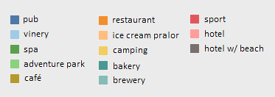
Proxies (1): Breeding
Balaton: state subsidies announced but not distributed until ownership changes happened
laxing regulations to allow hotel building in camping places, lowering taxes, vacation program (for the poor, going to the hotels of Mészáros and Tiborcz)
Source: K-Monitor

Slide 14
Proxies (2): Odds
Changing odds of major construction companies in Hungarian public procurement tenders (odds = number of tenders won / number of tenders lost)
Mészáros’ odds far exceeds those of patronally not embedded companies
Source: CRCB

Slide 15
Proxies (3): State contracts
Number of tenders won by Lajos Simicska vs István Garancsi + Lőrinc Mészáros + István Tiborcz (2013-2015)
Orbán-Simicska war in 2015, followed by a reduction in winning tenders
Source: 444

Slide 16
Proxies (4): State loans
Banks financing some of Orbán’s oligarchs (2018, billion HUF) → 2/3 of loans are from banks in which the oligarchs themselves are owners
Loans of Lőrinc Mészáros:
49 billion HUF in 2018
129,7 billion HUF in 2021 (according to „The 100 Wealthiest Hungarians” publication)
Source: Atlatszo

Slide 17
Proxies (5): State subsidies
State support distributed in Kisfaludy Tourism Development Program (2020, million HUF)
300 billion HUF in total → 16,000 participants, 80 largest getting ca. 2/3 of the support
Over ½ of all money to patronally embedded actors (ca. 30 actors)
Source: Válasz Online

Slide 18
Proxies (6): Profits
Top figure: rate of profit (profit after tax / turnover) for construction companies in Hungary (%)
Bottom figure: On average, how much did net contract prices exceed the estimated value of tenders won by certain construction companies in 2017-2018 (%)
Source: Válasz Online, CRCB

Slide 19
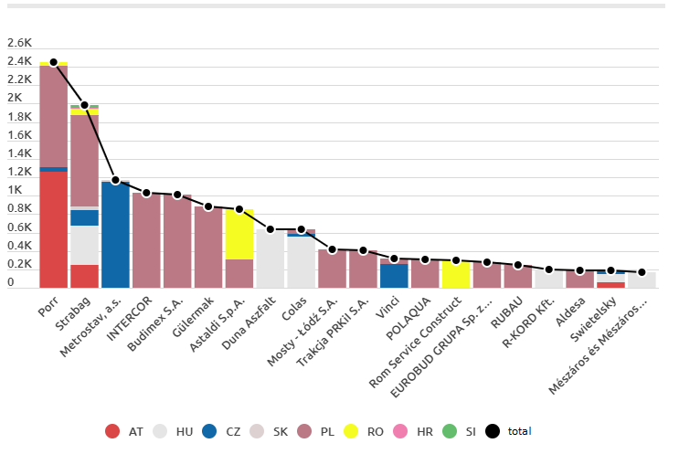
Proxies (7): Production for export
Top 20 winners of construction contracts in Central Europe in 2018 by country of contracts won (million EUR)
Patronal companies (Duna Aszfalt, R-KORD, Mészáros és Mészáros etc.) win only domestic contracts, as opposed to others (Porr, Strabag etc.)
Source: G7

Slide 20
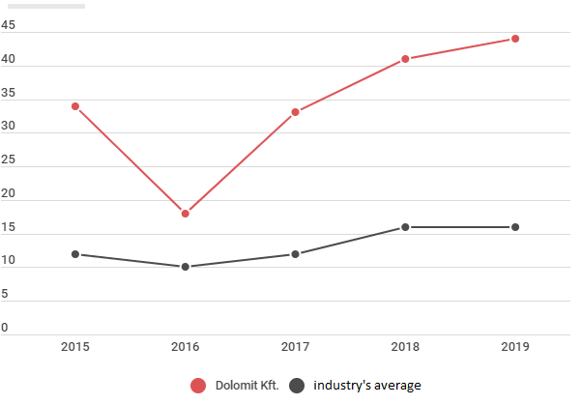
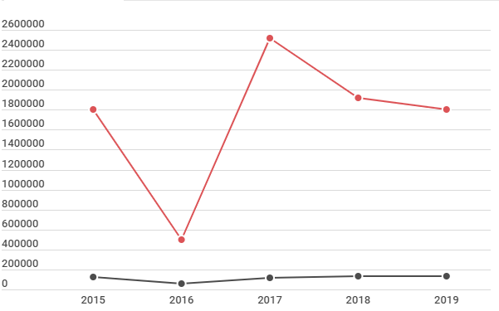
Proxies (8): Dividends
Rate of profit (top figure, %) and sum of dividends (bottom figure, 1000 HUF) of Dolomit Ltd. vs. industry’s average, 2015-2019
Dolomit Ltd. is the quarry of Győző Orbán, Viktor Orbán’s father
Both profits and dividends far exceed the industry’s average

Slide 21
Who is the real owner?
1

Slide 22
Property Rights in Patronal Autocracy
 |  |  | Market economy |  | Relational economy
 |  |  | De jure = de facto Matching |  | De jure =/= de facto Collusion (offshore, front man)
 |  |  | Normative / persistent regulations |  | Discretional / ad hoc regulations
Endogenous rights of ownership |  | The right | Politician | Entrepreneur | Poligarch | Front man | Oligarch
Use rights | Access | to enter a defined physical property | - | + | + | + | +
 | Withdrawal | to obtain the ‘products’ of a resource | - | + | + | - | + -
Control rights | Management | to regulate internal use patterns and transform the resource by making improvements | - | + | + - | + - | +
 | Exclusion | to determinate who will have an access right, and how that right may be transferred | - | + | + | - | + -
 | Alienation | to sell or lease the rights of management and exclusion | - | + | + | - | + -

Slide 23
Proxies of real status of property
„The moment of truth” | Examples from…
 | liberal democracy (entrepreneur) | patronal autocracy (oligarchs, front men)
Donation of property | creation of / donation to foundation via transferring monetary property (Soros, Gates, etc.) | transferring non-monetary property (e.g. nearly 500 media outlets to KESMA, Spéder)
Change of state influence after marriage | no change or deterioration of state influence (conflict of interest) | adoption: spouses become sudden winners of state subsidies and procurements (Cecília Rogán etc.)
Separation of property as a result of divorce | separation among the spouses following legal guidelines (e.g. Bezos, Gates) | the wife takes a part of only what actually belonged to the front man (i.e., not to the poligarch behind him)
Inheritance upon the event of death | remains within actual family (e.g. Sándor Demján) | remains within adopted political family (e.g. Andy Vajna)
Notes:
Family relationship is a proxy of informal embeddedness.
Gift
A Mészáros-lány udvarlójának közbeszerzési „árfolyama” hogyan változik

Slide 24
The patronal network in a post-communist single-pyramid system can be characterized as an adopted political family, because:
different networks of extended personal acquaintance are organized into a single adopted political family (political-economic clan);
not only individuals, but families / adopted families are incorporated;
it is informal, without formal membership;
it extends over formal institutions;
it is based on patronal, and not organizational loyalty (there is no free entrance into or free exit from it);
the position within the adopted political family does not converge necessarily with the formal administrative positions;
its power was based on the merger of political and economic “resources”;
it follows the cultural patterns of rule of the patriarchal family or clan.

Slide 25
Measuring the adopted political family
Family relationship is a proxy of informal embeddedness → forming a family relationship means (1) adoption of the person and (2) appreciation of existing formal and informal relations (family relationships, friendships)
Adoption can be measured in economic terms
wealth accumulation as a result of not market performance or inheritance (as in a class structure) but as a result of adoption
spouses (Anikó Lévai, Cecília Rogán, Szilvia Szijjártó-Nagy, István Tiborcz etc.)
parents (Győző Orbán etc.)
children (Győző Orbán jr., Ráhel Orbán)
commonalities: no pre-adoption economic activity, fast ramp-up phase, large dividends etc.

Slide 26
Thank you for your attention.
1

