Slide 1
Towards a Set of Indices for Relational Economy:
The Case of Hungary
Based on Bálint Madlovics, Bálint Magyar, „Towards a Set of Indices for Relational Economy on the Example of Hungary” (Acta Oeconomica, under publication).
Kotor, Montenegro
September 6, 2022
1

Slide 2
How to measure the difference between entrepreneurs and oligarchs?
Legal status is normally accompanied by a measurable and therefore scalable position.
What can we do when the position exists, but it has no legal status?
How to find data that can be used as proxies reflecting the legally undefined, de facto, position?

Slide 3
Possible ways of measuring informal patronalism: proxies of oligarch embeddedness
 | Oligarch | Proxy
Patronal breeding | established by state arbitrariness, special laws or directed privatization | share of assets obtained with the help of state predation / discretional treatment
 | market activity easily monopolized by the state | intensity of competition in the given industry
 | fast ramp-up phase, becoming „national champion” very soon | above-average growth of turnover in the industry
Wealth accumulation | concessions, public procurement with guided bids | odds of winning public procurements
 |  | share of state contracts in total business activity
 | receiving dedicated loans from the patronal network | share of loans from state, state-reorganized, and/or transit-nationalized banks
 | receiving dedicated state subsidies | ratio of state subsidies and total assets
Operation | non-innovative, patronal-network oriented business, optimized for domestic rent-collection | share of production for export
 | overpricing depending primarily on patronal relationships | above-average scale of taxed profits in the industry
Consolidation | profits drawn out of the venture, utilized in other (less transparent) fashion | above-average scale of dividends in the industry
 | self-defending by loyalty demonstration, paying protection monies | financing the chief patron’s hobby (TAO payments: share of football in all ~, share of Felcsút in football ~)
Notes:
TAO: az önkéntes adomány látszata mögött védelmi pénz szedése / beágyazottság vásárlása (self-defending mechanism: a TAO egy példa, de az ajándékozás is!)
Az össz-TAO-ból mennyi megy focira; a foci-TAO-ból mennyi megy Felcsútra
A Felcsútra TAO-zó cégek (Felcsút: az alapítvány alapítója Orbán, tényleges tulajdona: kinevezési jogok, csapatösszeállításba való beleszólás)
árbevételének hány százaléka származik EU-s/költségvetési forrásból; közbeszerzési odds
technology vs. administrative (rent-seeking) coordinator
ratio between the profit of main actor and subcontractors (oligarchs take profit out via subcontractors to hide it)
stability of chains of subcontractors (competition vs. permanent chains)
the value of owned assets vs. those of the subcontractors
turnover / employee

Slide 4
Creating a radar chart of patronalism

Slide 5
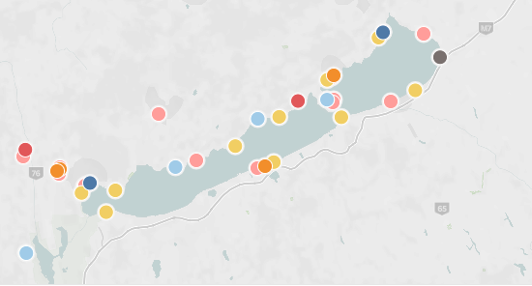
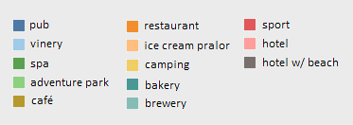
Proxies (1): Breeding
Balaton: state subsidies announced but not distributed until ownership changes happened
laxing regulations to allow hotel building in camping places, lowering taxes, vacation program (for the poor, going to the hotels of Mészáros and Tiborcz)
Source: K-Monitor

Slide 6
Proxies (2): Odds
Changing odds of major construction companies in Hungarian public procurement tenders (odds = number of tenders won / number of tenders lost)
Mészáros’ odds far exceeds those of patronally not embedded companies
Source: CRCB

Slide 7
Proxies (3): State contracts
Number of tenders won by Lajos Simicska vs István Garancsi + Lőrinc Mészáros + István Tiborcz (2013-2015)
Orbán-Simicska war in 2015, followed by a reduction in winning tenders
Source: 444

Slide 8
Proxies (4): State loans
Banks financing some of Orbán’s oligarchs (2018, billion HUF) → 2/3 of loans are from banks in which the oligarchs themselves are owners
Loans of Lőrinc Mészáros:
49 billion HUF in 2018
129,7 billion HUF in 2021 (according to „The 100 Wealthiest Hungarians” publication)
Source: Atlatszo

Slide 9
Proxies (5): State subsidies
State support distributed in Kisfaludy Tourism Development Program (2020, million HUF)
300 billion HUF in total → 16,000 participants, 80 largest getting ca. 2/3 of the support
Over ½ of all money to patronally embedded actors (ca. 30 actors)
Source: Válasz Online

Slide 10
Proxies (6): Profits
Top figure: rate of profit (profit after tax / turnover) for construction companies in Hungary (%)
Bottom figure: On average, how much did net contract prices exceed the estimated value of tenders won by certain construction companies in 2017-2018 (%)
Source: Válasz Online, CRCB

Slide 11
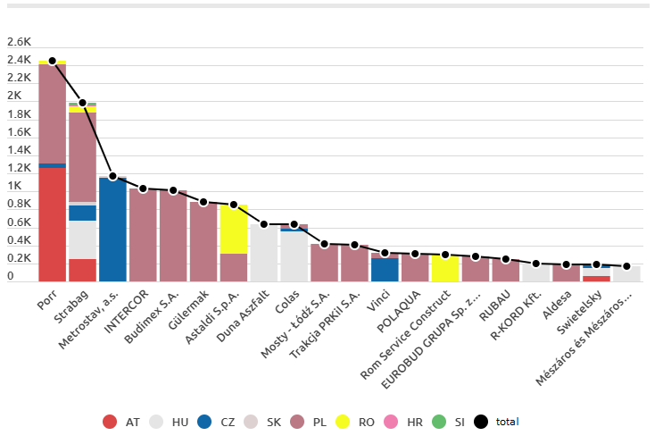
Proxies (7): Production for export
Top 20 winners of construction contracts in Central Europe in 2018 by country of contracts won (million EUR)
Patronal companies (Duna Aszfalt, R-KORD, Mészáros és Mészáros etc.) win only domestic contracts, as opposed to others (Porr, Strabag etc.)
Source: G7

Slide 12
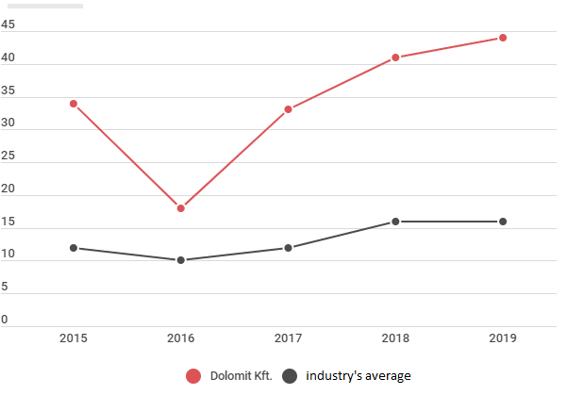
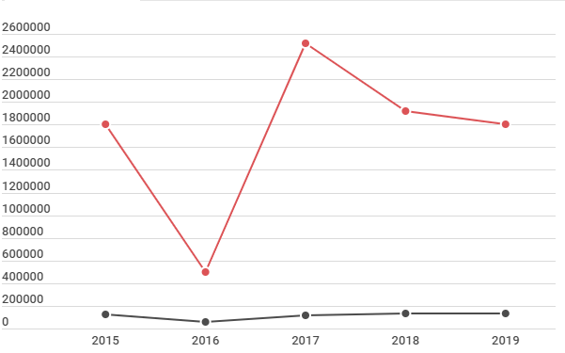
Proxies (8): Dividends
Rate of profit (top figure, %) and sum of dividends (bottom figure, 1000 HUF) of Dolomit Ltd. vs. industry’s average, 2015-2019
Dolomit Ltd. is the quarry of Győző Orbán, Viktor Orbán’s father
Both profits and dividends far exceed the industry’s average

Slide 13
Thank you for your attention.
1

